Slide 1
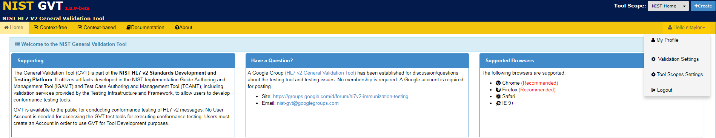
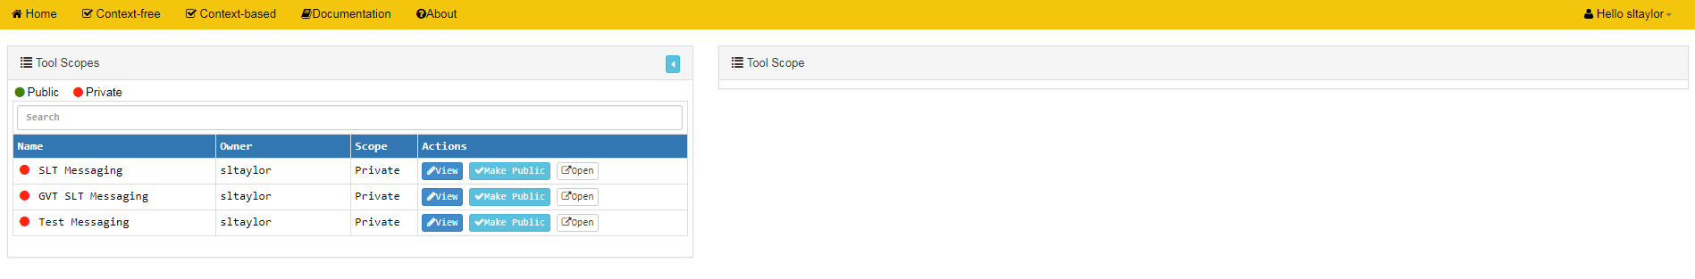
Accessing and Updating Tool Scope Settings (1)
1
From the Hello dropdown menu that displays to logged-in Account Users with Deployer Role, select Tool Scope Settings to add or edit Settings information for a Tool Scope
info
Tool Scope Settings edit screen
info
Current list of both Private and Public Tool Scopes created by GVT Account User who is logged in is displayed
info
info
View button allows Account Users with Deployer Role to display the Tool Scope Settings edit screen for the desired Tool Scope
Open button allows Account Users with Deployer Role to open a separate window to display the desired Tool Scope
info
√Make Public button displays for Account Users with Publisher Role

Slide 2
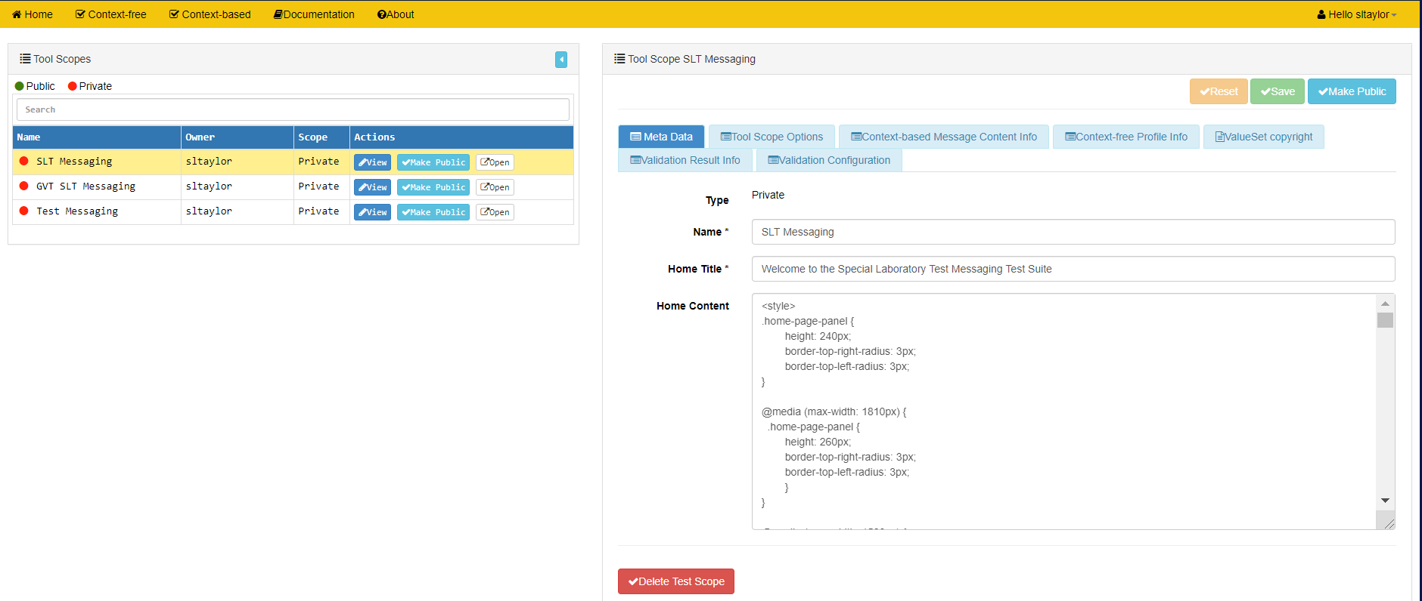
Accessing and Updating Tool Scope Settings (2)
info
Optional: For Account Users with Publisher Role, click on √Make Public to make this Tool Scope available to all GVT users
info
“Private” is default setting; if an Account User with Publisher privileges makes the Tool Scope Public, then “Public” would display here
info
Tool Scope Settings edit screen for selected Tool Scope
Click on View button to display the Tool Scope Settings edit screen for the desired Tool Scope
2
ool

Slide 3
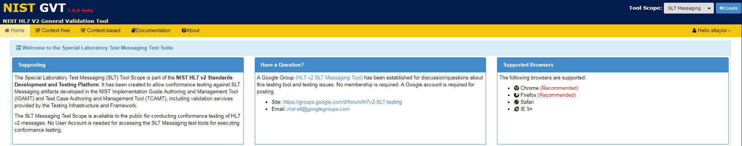

Accessing and Updating Tool Scope Settings (3)
shows where this information is used
3
Using the Tool Scope Settings “Meta Data” edit screen, add or edit Meta Data information
Save Meta Data Tool Scope Settings or select another tab on this screen to add or edit data
4
Click on √Delete Tool Scope to delete this entire Tool Scope
info

Slide 4
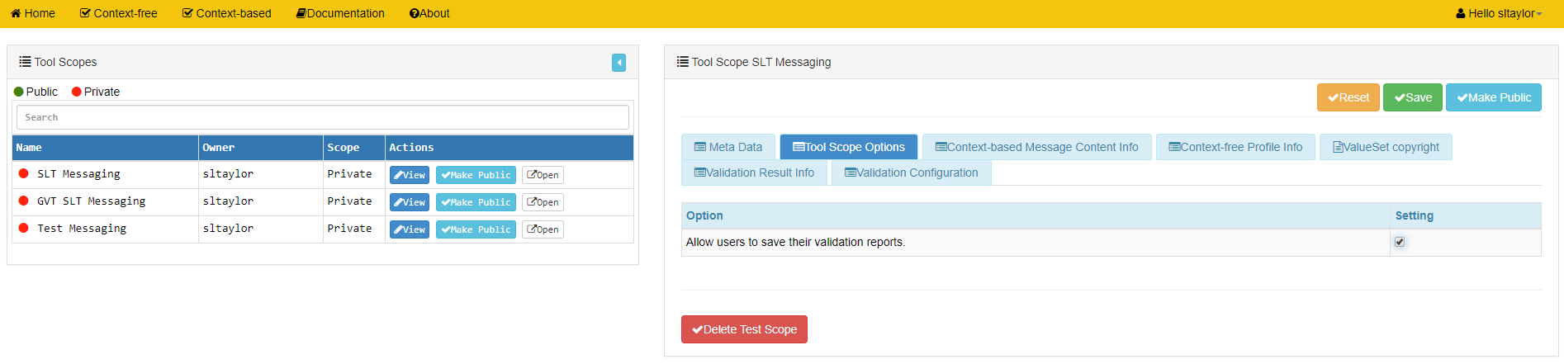

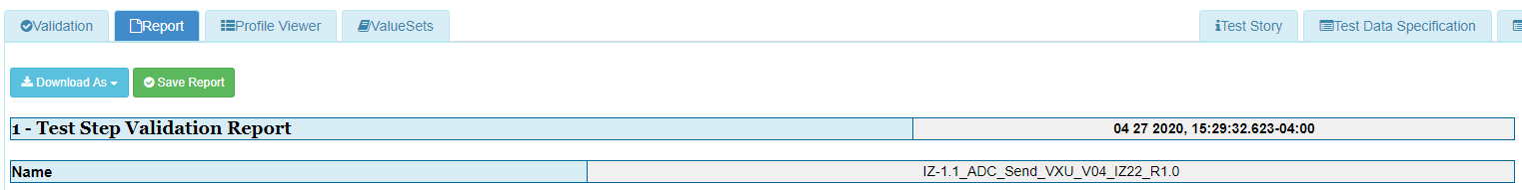
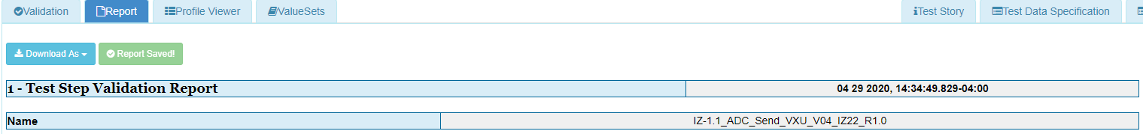
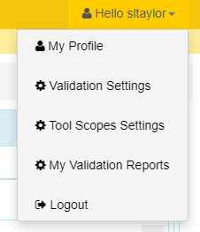
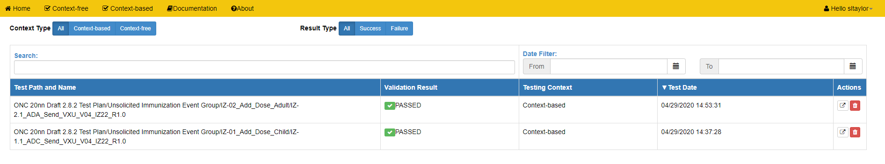
Accessing and Updating Tool Scope Settings (4)
shows where this information is used
5
Select the Tool Scope Options tab in the Tool Scope Settings edit screen and click on the Setting check box to activate the save validation reports function
Save Tool Scope Options Setting or select another tab on this screen to add or edit data
info
Online Validation Report screen for a Test Step when save validation reports setting is activated
Click Save Report
6
7
Use Context Type, Search, Result Type, and Date Filter to modify the list
info
My Validation Reports option is added to Hello menu for the Account User
Open Report or Delete Report
8
9
info
My Validation Reports screen with list of Saved Reports

Slide 5
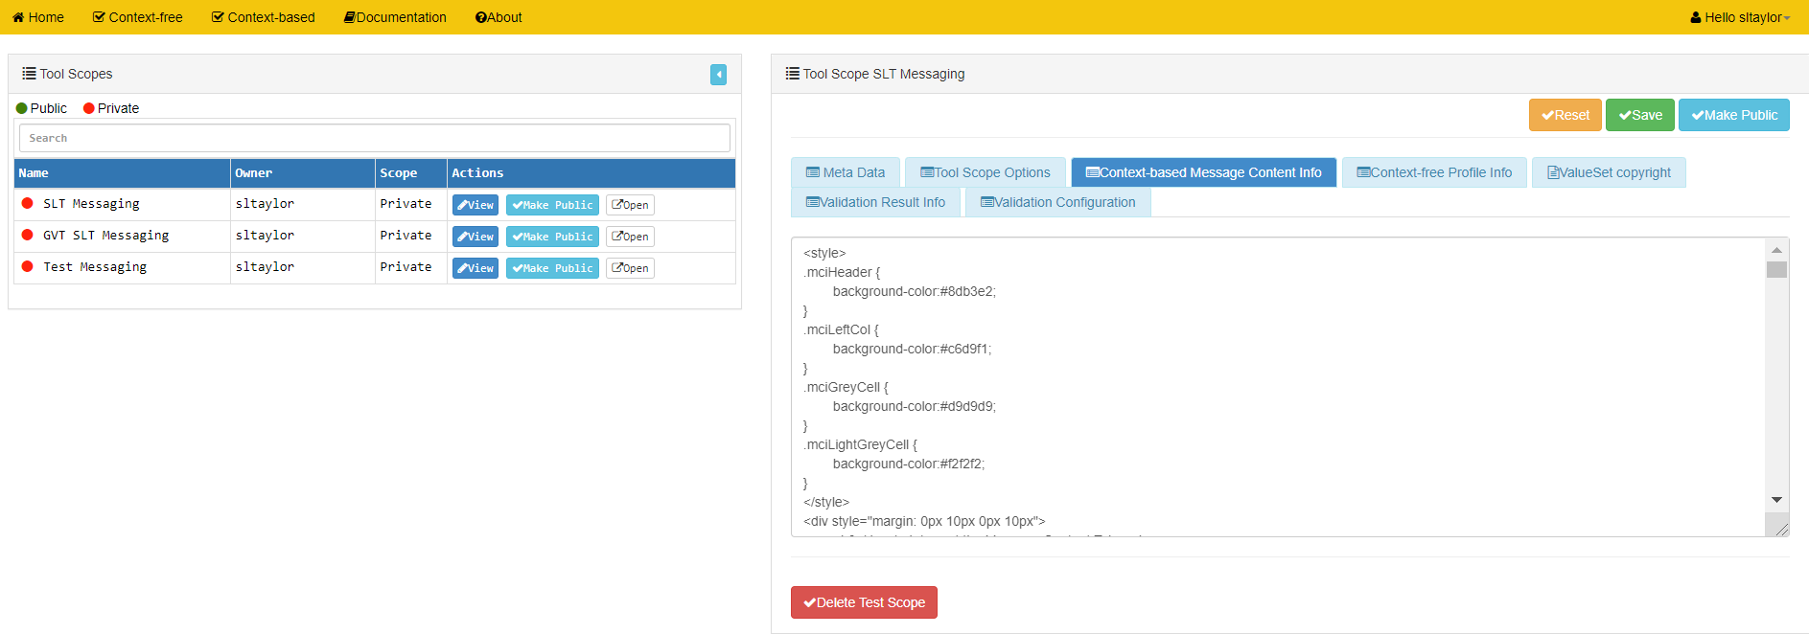
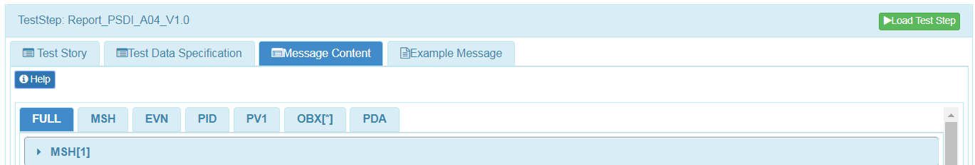
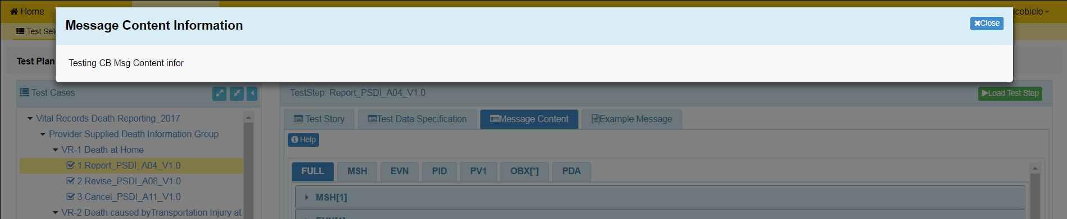
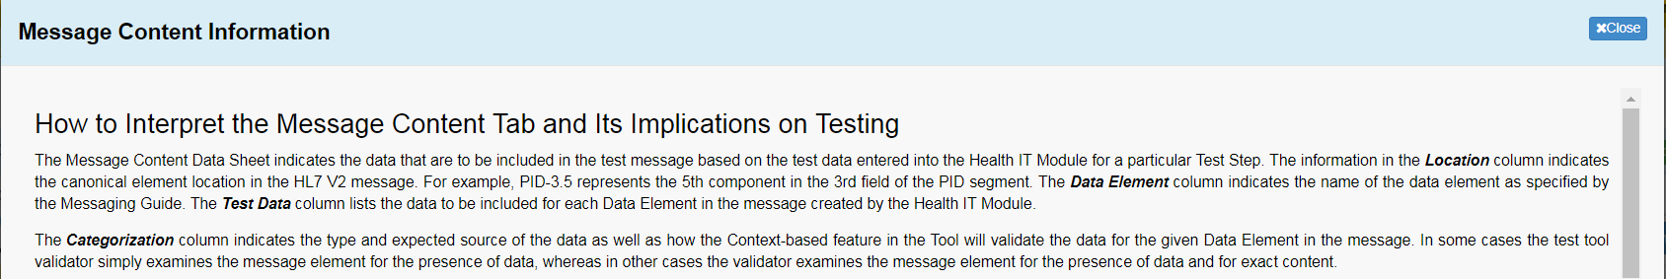
Accessing and Updating Tool Scope Settings (5)
shows where this information is used
10
Select the Context-based Message Content Info tab in the Tool Scope Settings edit screen and add or edit this information
Save Context-based Message Content Info or select another tab on this screen to add or edit data
11

Slide 6
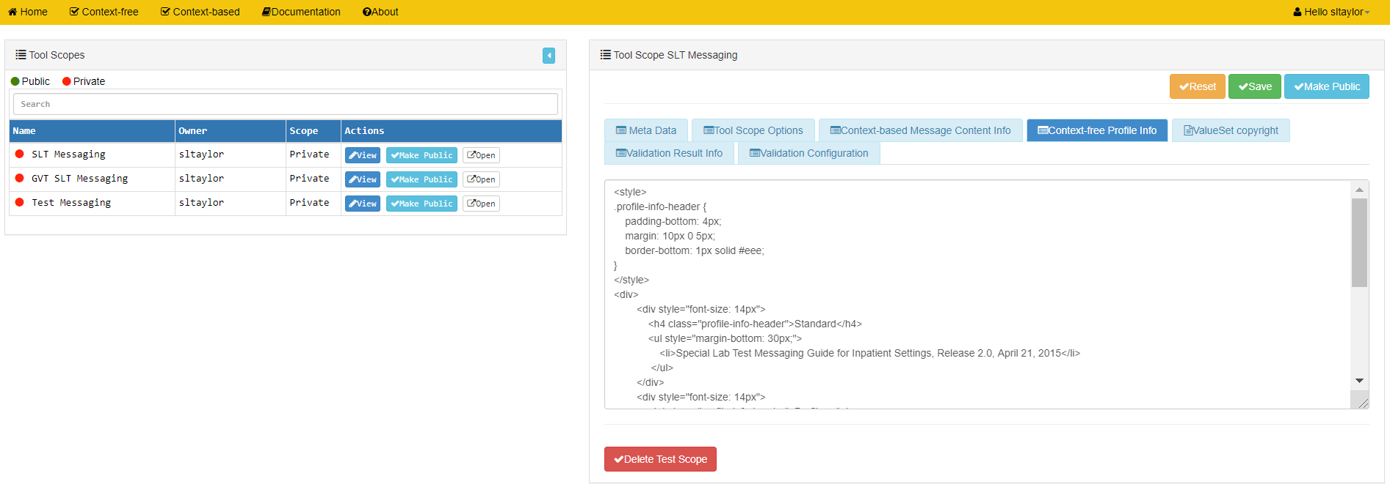
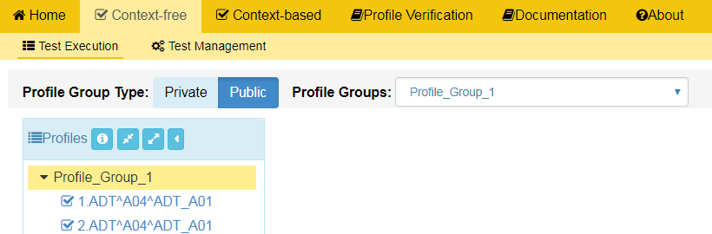
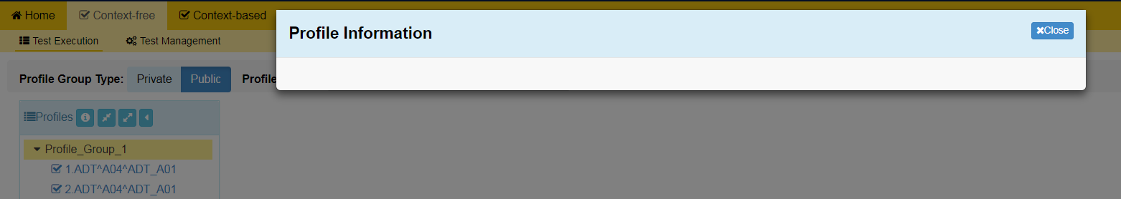
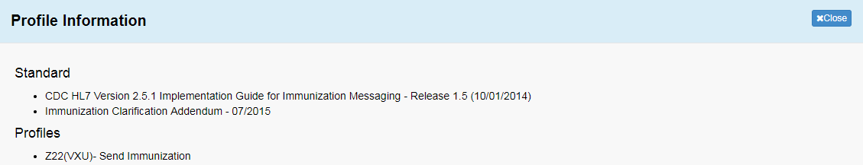
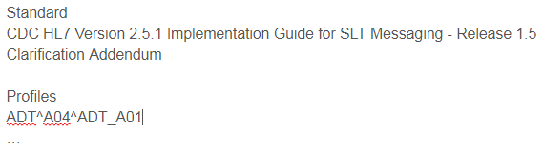
Accessing and Updating Tool Scope Settings (6)
shows where this information is used
12
Select the Context-free Profile Info tab in the Tool Scope Settings edit screen and add or edit this information
Save Context-free Profile Info or select another tab on this screen to add or edit data
13

Slide 7
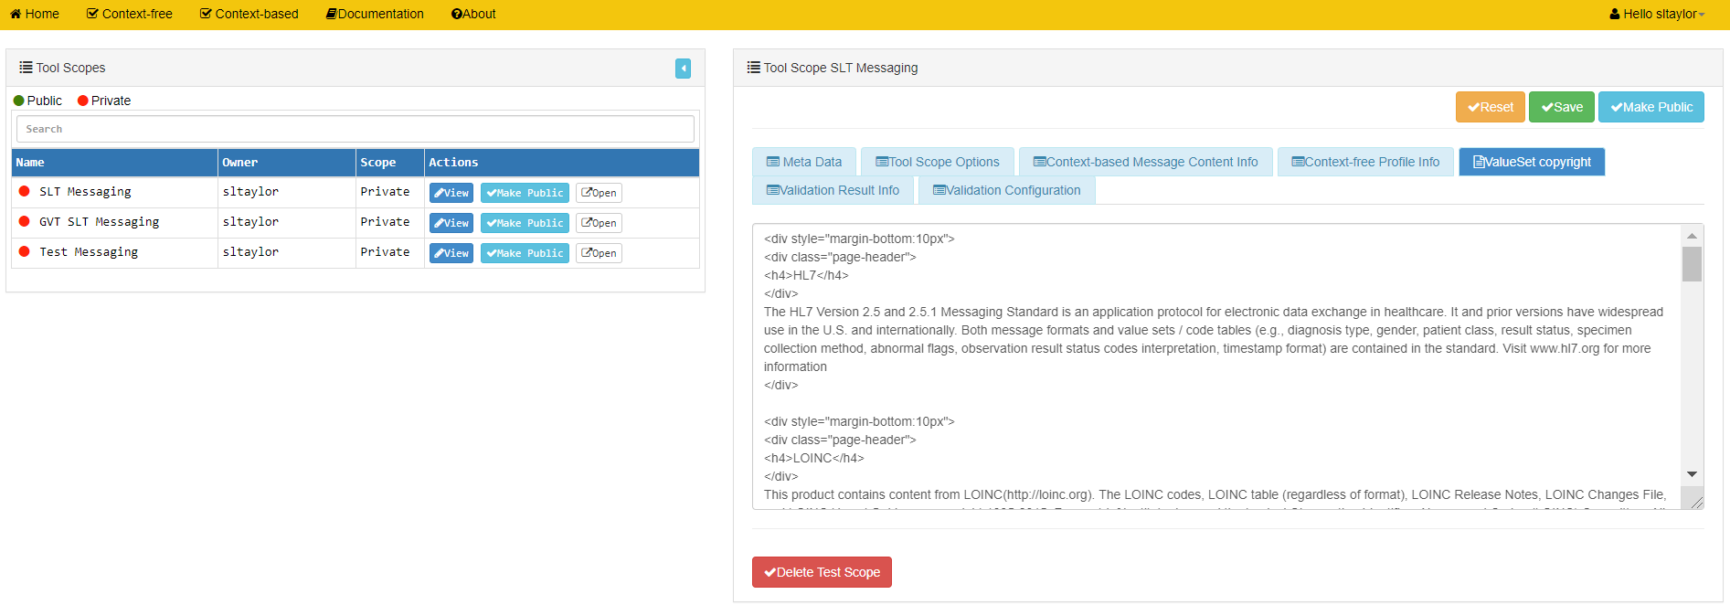
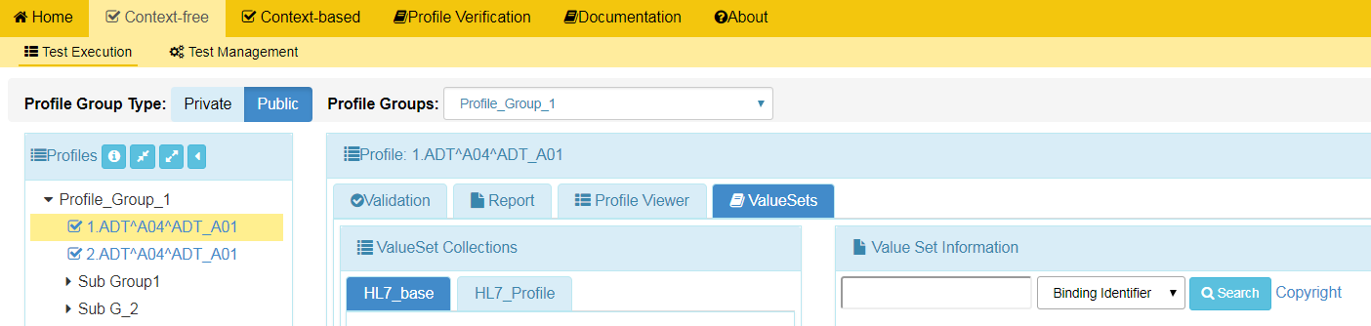
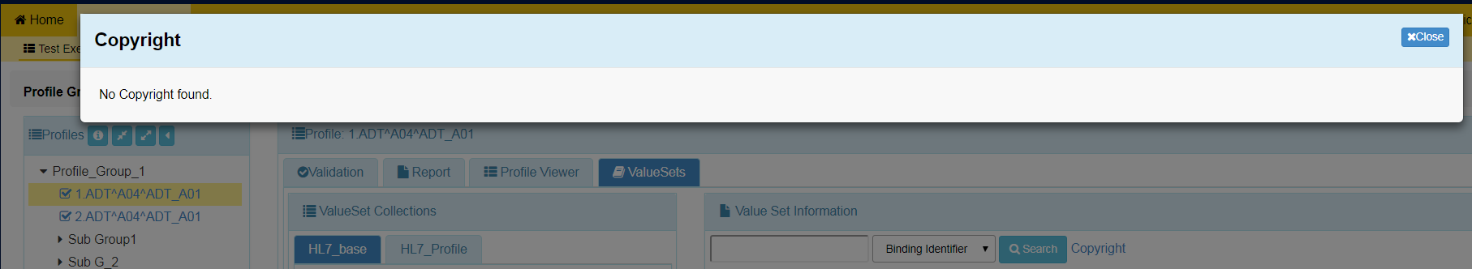
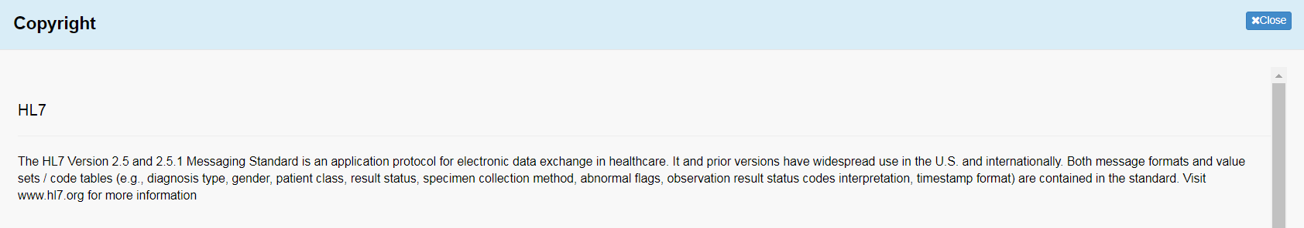
Accessing and Updating Tool Scope Settings (7)
shows where this information is used
14
Select the ValueSet Copyright tab in the Tool Scope Settings edit screen and add or edit this information
Save ValueSet Copyright or select another tab on this screen to add or edit data
15

Slide 8
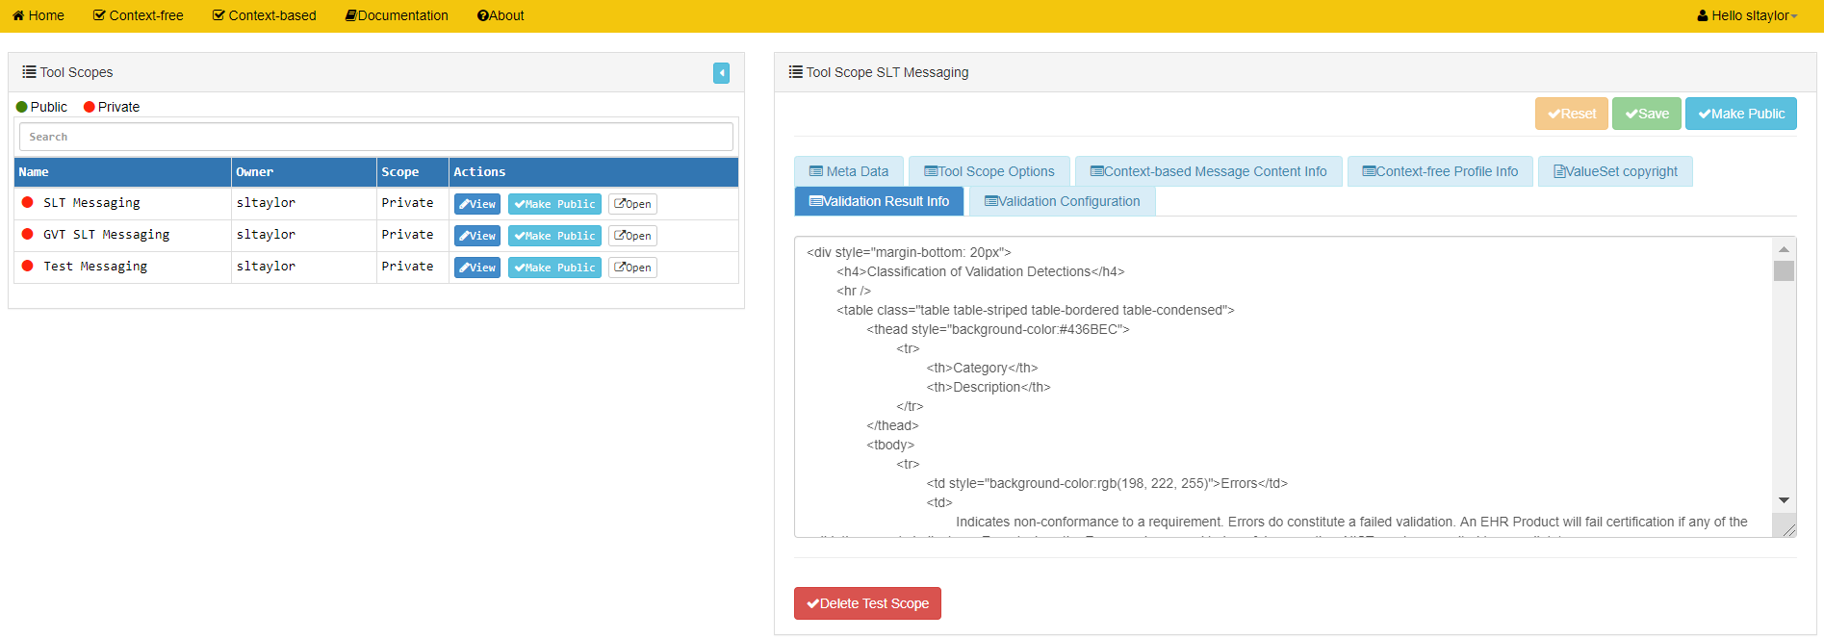
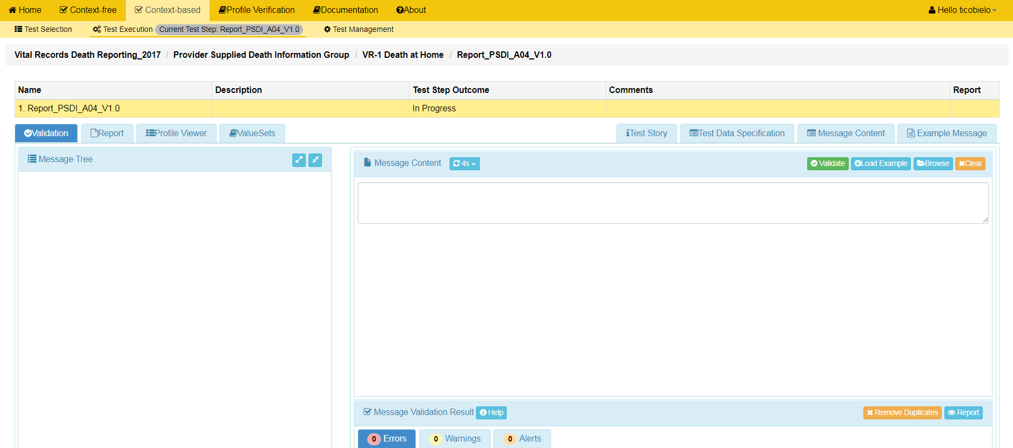
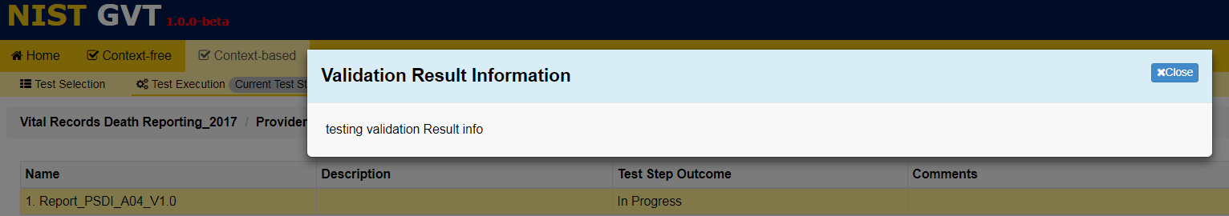
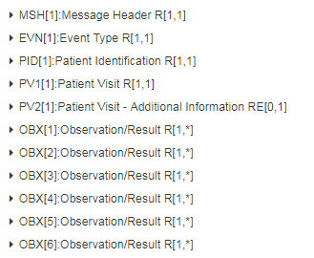
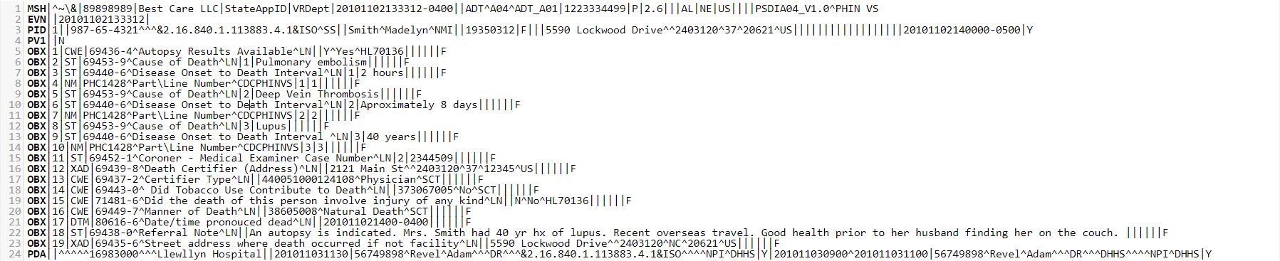
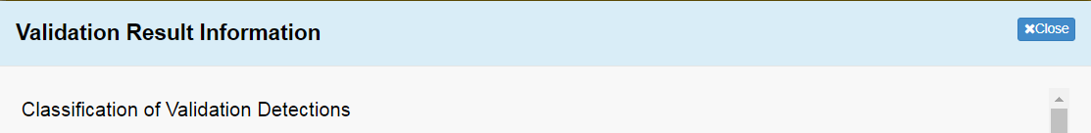
Accessing and Updating Tool Scope Settings (8)
shows where this information is used
16
Select the Validation Result Info tab in the Tool Scope Settings edit screen and add or edit this information
Save Validation Result Info or select another tab on this screen to add or edit data
17

Slide 9
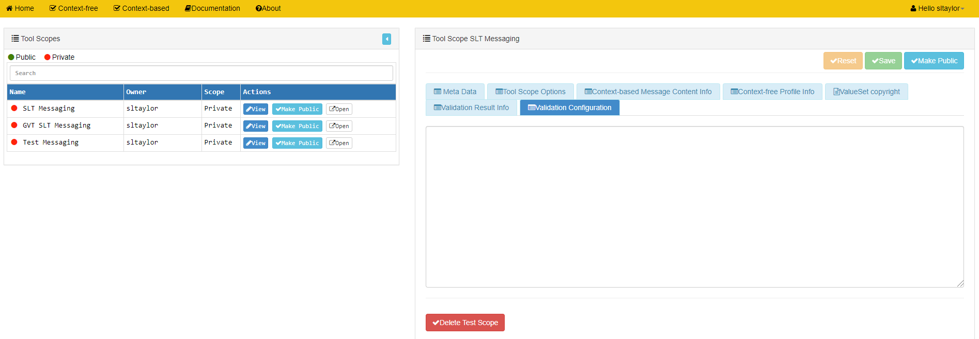
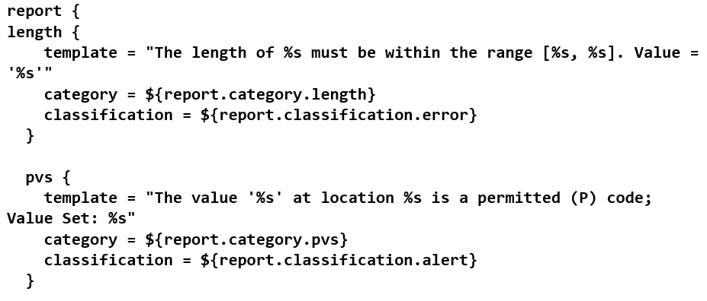
Accessing and Updating Tool Scope Settings (9)
shows where this information is used
18
Select the Validation Configuration tab in the Tool Scope Settings edit screen and add or edit this information
Save Validation Configuration or select another tab on this screen to add or edit data
19
The Validation Configuration tab is used for inputting configuration text that instructs the validation engine regarding how to execute the various detections.
Contact the Website Administrator for information on how to use this tab.

